Slide 1
the colonial gaze
Arts
Kar

Slide 2
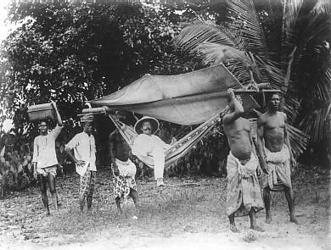
example of an analysis
description:
background: trees, bushes
foreground: 6 men (5 men of color and one white person), carrying boxes and a hammock, men of color wear tribal clothes
colour and contrasts:
effects
light, sharpness, information value:
effects
composition:
effects

Slide 3
example of an analysis
description:
colour and contrasts:
effects
light, sharpness, information value:
effects
composition:
effects

Slide 4
example of an analysis
description:
colour and contrasts:
effects
light, sharpness, information value:
effects
composition: axis focused on the white person
effects: focused on the white person

Slide 5
example of an analysis
description:
colour and contrasts:
effects
composition: golden ratio – white man still in the center, all men are in the lower part of the golden ratio, the foreground is in the lower section of the golden ratio
Effects: white man is still the most important subject in this photo,
light, sharpness, information value:
effects

Slide 6
example of an analysis
description:
colour and contrasts:
effects
light, sharpness, information value:
effects
composition:
effects: the white person sticks out more due to the form contrast

Slide 7
example of an analysis
colour and contrasts:
black & white contrast,
back- & foreground contrast, skin color contrast, contrast of quantity
description:
light, sharpness, information value:
historical photo,
staged photo,
effects
composition:
effects

Slide 8
example of an analysis
description:
colour and contrasts:
effects
light, sharpness, information value:
effects
composition:
effects

Slide 9
example of an analysis
description:
colour and contrasts:
effects
light, sharpness, information value:
effects
composition:
effects

Slide 10
goal of this lesson
example of an analysis 10‘
analysis in groups 15‘
Presentation 15‘
the colonial gaze 10‘
poster: how to make „the colonial gaze“ visible 25‘
26.01.

Slide 11

analysis in groups
Form groups (3-4 students)
Analyse the photo in your ppt like we did in the example.
Make references to the speeches you read in your English lessons. Take notes.
(15 minutes)
work in groups

Slide 12
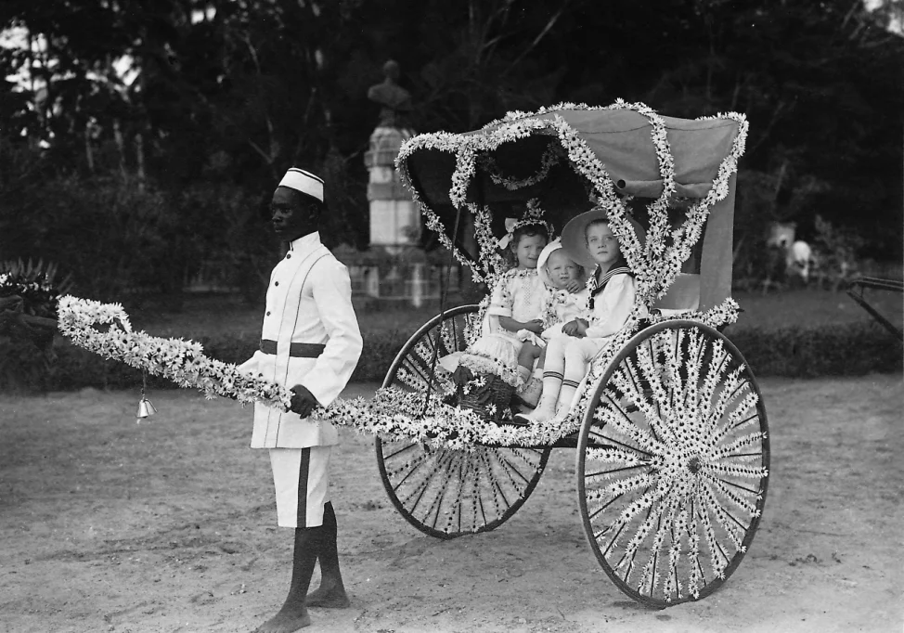

Slide 13
the colonial gaze
english advanced course
Leonardt, Marcel, Marwin

Slide 15
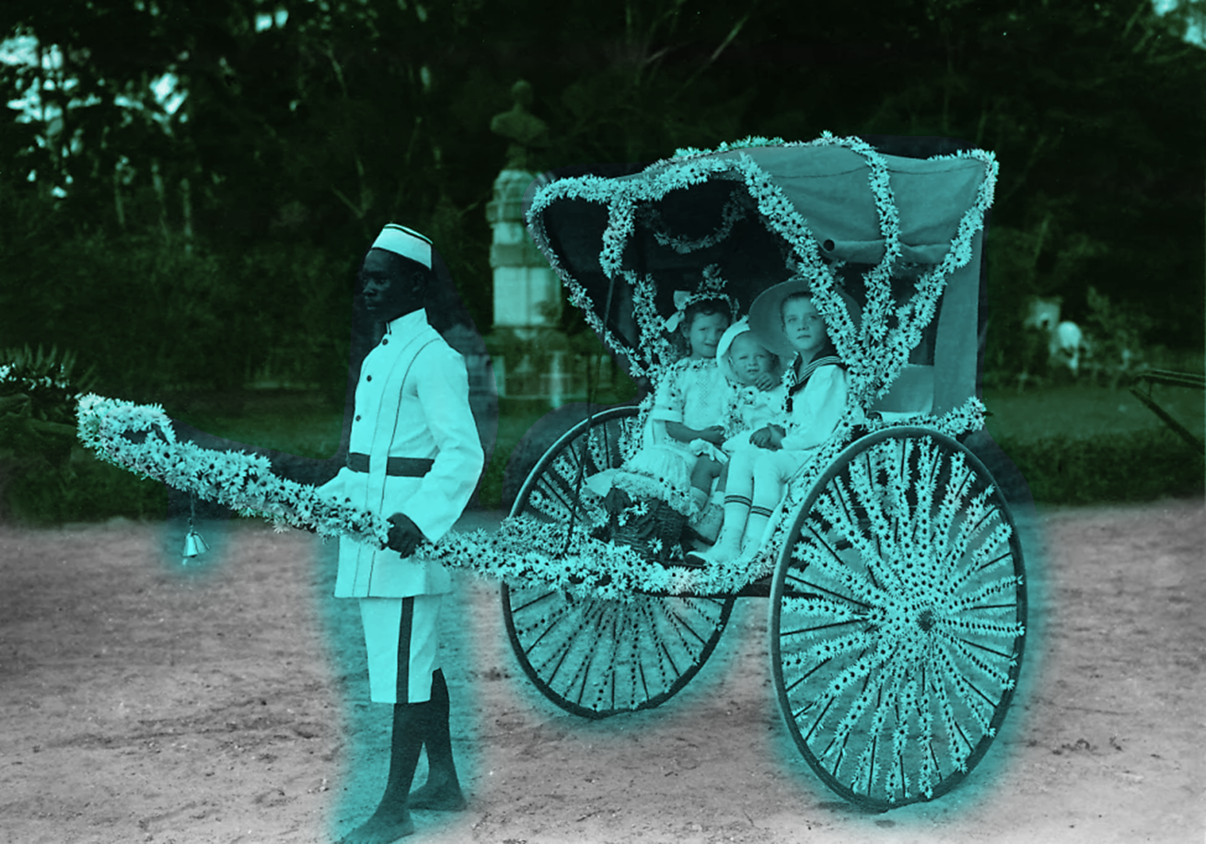
Description:
foreground:
one person of color holding a wagon coverd in flowers, with three white children sitting in it
the person of color is clothed with white slim clothes with short pants and no shoes
the children are clothed with white nobly clothes
background:
mainly undergrowth, with a big statue right behind the wagon
foreground
background

Slide 16
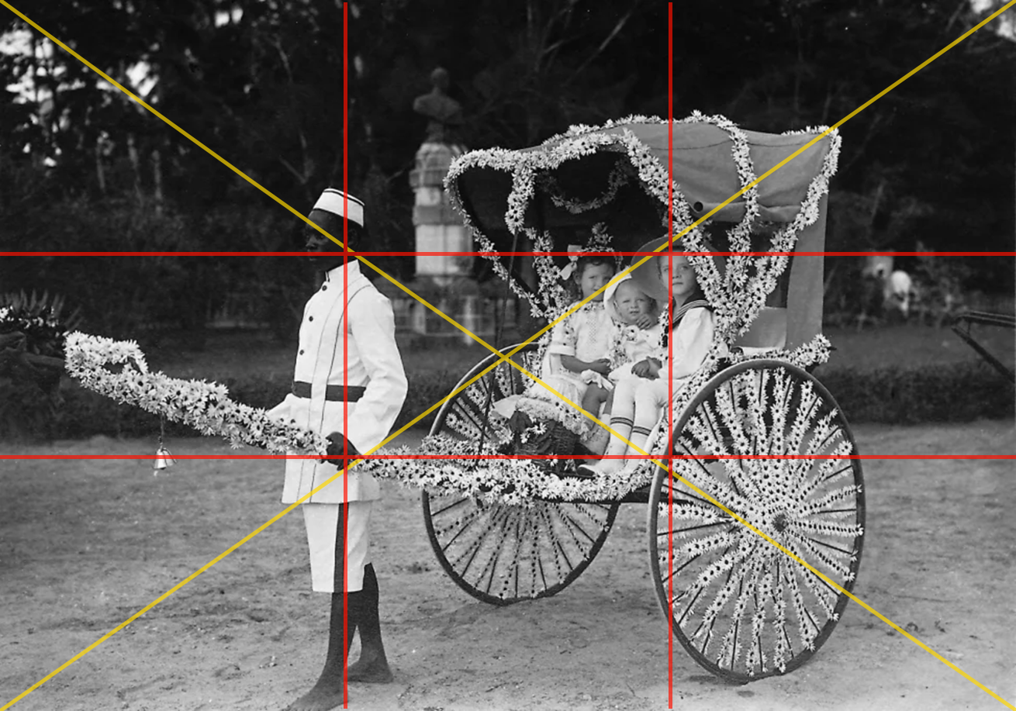
Composition:
The heads of the children and the person of color are aligned on a line
the children and the wagon are centered
The person of color is centerd to the left
Effects:
person of color sticks out
the focus is located on the children
golden section
diagonal line symmetry

Slide 17
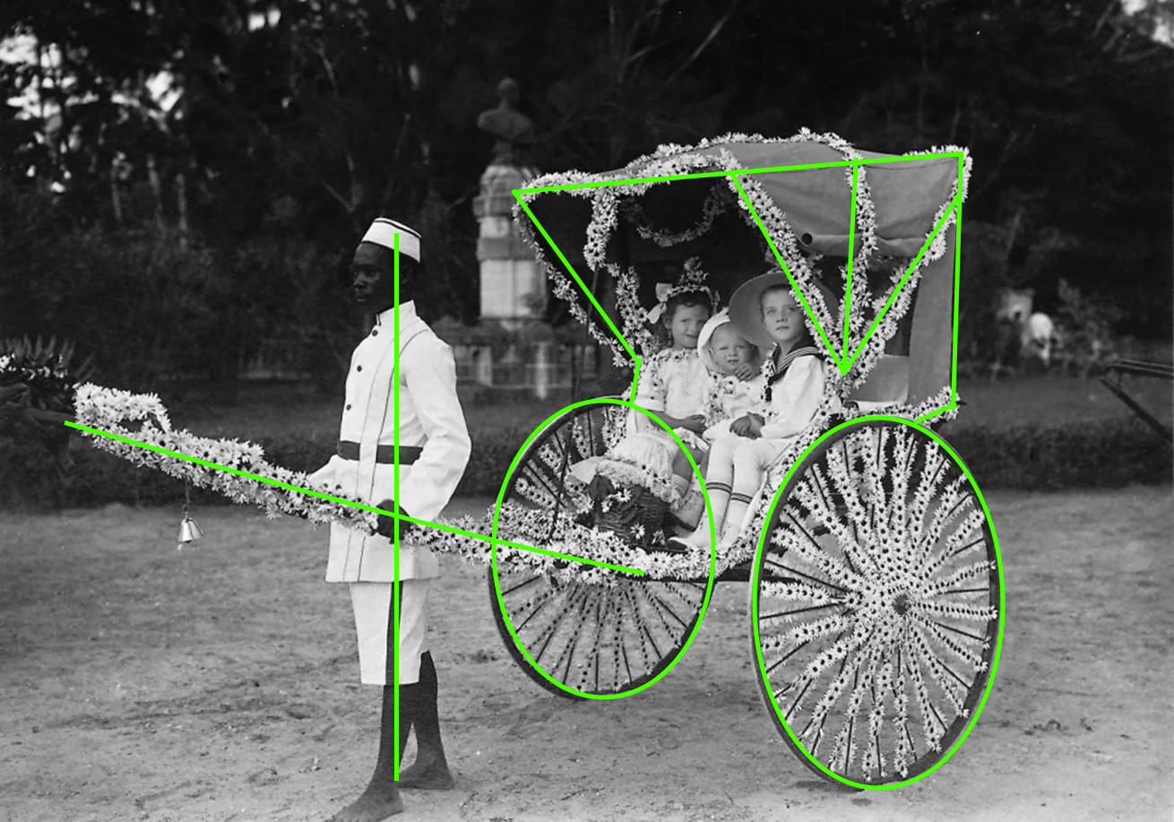
Posture/Composition:
The black man is standing upright, while the children are sitting in the wagon comfortably
many formations at the wagon
Effects:
Kids superior
Man disciplined
Shapes at the wagon catches
focus
composition lines

Slide 18
Light/sharpness:
unsharp background,
focus lies on the wagon and the people
Contrast:
light/dark contrast

Slide 19
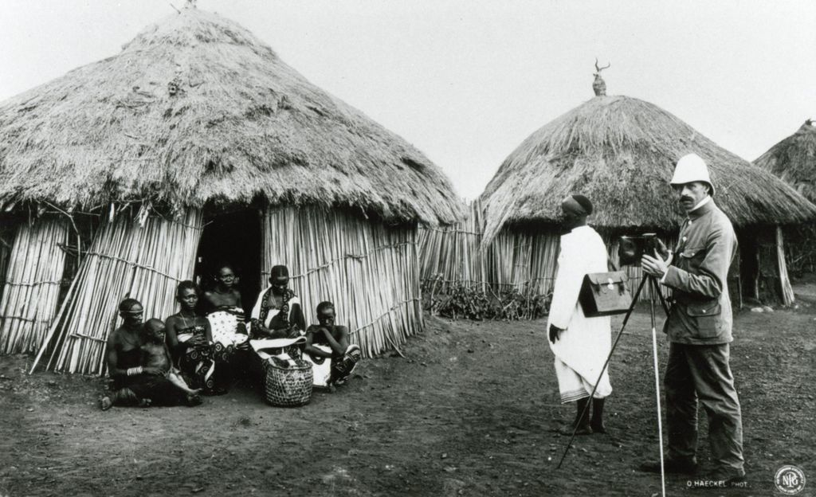

Slide 20
The Colonial Gaze
Tini
Emilia
Jonna

Slide 21
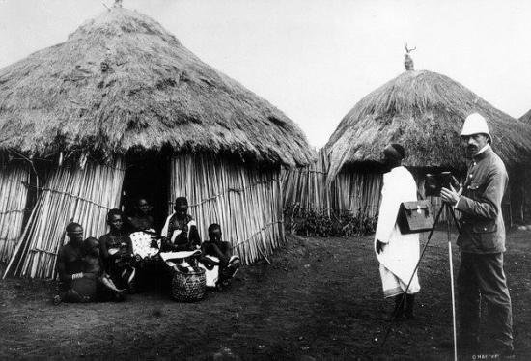
Axes of Compostion

Slide 22
Golden Ratio

Slide 23
Axes of People
Axes of Elements

Slide 24
Description
Foreground:
Black and white photograph from the time of imperialism, contrasts between surroundings and the brightly clothed man
Background:
huts in close and distant range; many people of colour cowering in front of a hut, dressed in rather dark clothes; a white man in a bright, white coat stands on the right corner with a camera; man behind him of colour is also dressed in white
Composition:
An unstable triangle from the middle of the cluster of humans to the white man; he is more striking due to colour and the proportion his body occupies in comparison to the other people (lenghthier vertically), another triangle, which is constructed by the pile of people: small —> big amount of humans within small space
Effects: separation of colonist and native people
Colour and contrasts: black and white, dark and light
Light, sharpness, information value:
Rather non-sharp, light enters from front and above, shadow on some of the people under the hutsˋ jut- out/ledge

Slide 25
Analysis
Pictures portray an imperialistic ideology by presenting the theory of the existence of an innate hierarchy between humans depending on the place of birth
  white man is bigger, occupies more space, other humans are cowering and seem scared
Well-clothed with a camera: seeming advanced in comparison
Humans are portrayed like animals (like an attraction/phenomenon) by being directed to stand somewhere in a tight group and look into a camera —> disrespect
Scenario is unnatural: photograph of someone making a photograph: staged and insinuated to appear a certain way

Slide 26
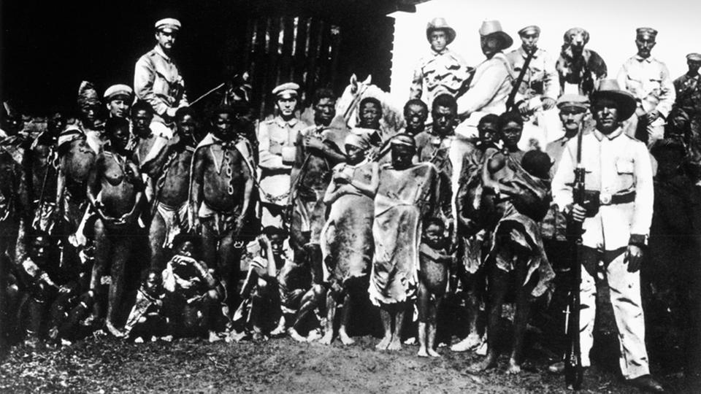

Slide 27
Composition + Effects
Composition:
the dressed ones are in the middle
the middle line separates the peoples upper and lower body
Effects:
they stick out more and are central
they Look even more lined up

Slide 28
Composition + Effects
Golden Ratio:
colonialists are above the upper line
most of the colonialists are on the right side
the dressed natives are in the central square
Effects:
colonialists seem more important and superior
the dressed natives look separated and different from the others

Slide 29
Composition + Effects
Composition:
lined up
straight body axis
Effects:
creates a symmetry
looks even more lined up
looks forced

Slide 30
Color/Contrast + Effects
Color and Contrasts:
black and white contrast; middle lighter than the side
colonizers wear more and lighter clothes
the natives are “drowning” due to their dark clothing and skin color
Effects:
colonialists stick out

Slide 31
Other things
Light:
daylight
the middle and right part is more illuminated
Sharpness:
total sharpness
Information value:
staged picture

Slide 32
Reference to speeches
Reference to the speech „The truth conception of empire“ by Joseph Chamberlain
they arent really dressed, so don‘t have as much prosperty as the Britains have
colonizers have shotguns → they use force to keep their control over the natives

Slide 33
Quellen
Folie 2: Geschichte - Kongo-Konferenz und Kolonialverbrechen (migazin.de); File:German colonial lord.jpg - Wikimedia Commons
Folie 12/Worksheet p. 3 Bilder: Spuren einer unrühmlichen Geschichte - die deutsche Kolonialherrschaft in Namibia | tagesschau.de
Abbildungen ppt und AB

Slide 34
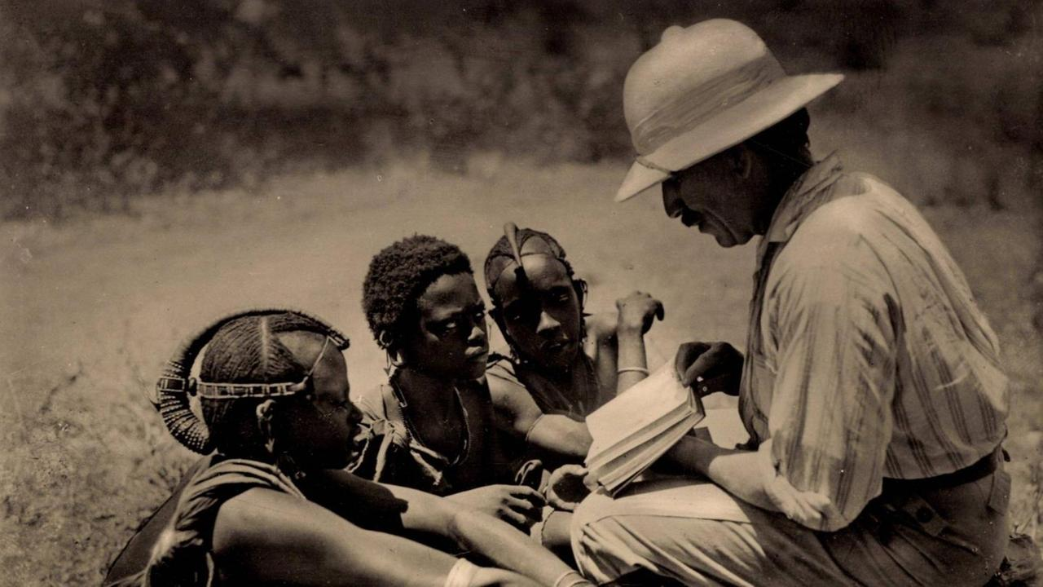

Slide 35
Description:
Persons -
three kids
one adult,
white man reading
a book to the kids
Kids having con-
traptions on their
heads
The man is wearing
„normal clothes“
Background:
a blurry field

Slide 36
Composition:
the heads of the kids are in the same row
Man looks at the kids in a diagonal line, so does the book
Effects:
creates a level headed atmosphere (senior teaches juniors)

Slide 37
Light/sharpness:
Muffled light, low saturation, natural light
Blurry background, focus lies on the persons
Contrast:
man stands out because of the light clothes

Slide 39
analysis in groups
Make references to the speeches you read in your English lessons. Take notes.
work in groups
Chamberlain reference
Teaching kids – increasing the educational and living standard

Slide 40
analysis in groups
Make references to the speeches you read in your English lessons. Take notes.
work in groups

Slide 41


presentation
presenters
Present your analysis to the other groups.
Explain the references you found to the speeches.
listeners
Listen closely, ask questions and add your own ideas.

Slide 42

the colonial gaze
Explain what „the colonial gaze“ means to you and how it is represented in the photo. Include the notes you took on references to the speeches.
discussion

Slide 43
the colonial gaze
Explain what „the colonial gaze“ means to you and how it is represented in the photo. Include the notes you took on references to the speeches.
discussion
displays the idea of the colonialsation
„bettering“
„education“
„ideology“

Slide 44

„How to make the colonial gaze visible“
Discuss how you could arrange the results of your analysis and your discussion to make the colonial gaze visible.
Create a presentation with your results.
Mind the rules of a successful layout.
(15 minutes)
Work in groups

Slide 45
Quellen
Folie 2: Geschichte - Kongo-Konferenz und Kolonialverbrechen (migazin.de); File:German colonial lord.jpg - Wikimedia Commons
Folie 12/14-17: Von Togo bis Kiautschou: SZ-Fotos von deutschen Kolonien - Politik - SZ.de (sueddeutsche.de)
Foli2e 19/21-23: LeMO Kaiserreich - Außenpolitik - Die Kolonie Deutsch-Ostafrika (dhm.de)
Folie 26-31: Bilder: Spuren einer unrühmlichen Geschichte - die deutsche Kolonialherrschaft in Namibia | tagesschau.de
Folie 34-18: Christliche Missionare - Wegbereiter und Kritiker der Kolonialmächte | deutschlandfunkkultur.de
ppt/worksheet UE 1 Art
Folie 2: Autor unbekannt, German_colonial_lord, ca. 1885, Maße unbekannt; [https://www.migazin.de/2020/09/23/kongo-konferenz-und-kolonialverbrechen/ und https://commons.wikimedia.org/w/index.phpcurid=2562913, Letzter Zugriff 03.05.2023]
Folie 12/14-17: Archiv - Süddeutschen Zeitung Photo, Autor unbekannt, Einheimischer Dienstbote mit deutschen Kindern im Jahr 1912 in Deutsch-Ostafrika, 1912, Maße unbekannt; [https://www.sueddeutsche.de/politik/deutsche-kolonien-wo-die-deutsche-flagge-unter-palmen-wehte-1.1937908, Letzter Zugriff 03.05.2023]
Folie 19/21-23: Deutsches Historisches Musuem/Lebendiges Museum Online: Autor unbekannt, In der Kolonie Deutsch-Ostafrika 1906, 1906, Maße unbekannt; [https://www.dhm.de/lemo/kapitel/kaiserreich/aussenpolitik/die-kolonie-deutsch-ostafrika.html, Letzter Zugriff 03.05.2023]
Folie 26-31: Autor unbekannt, Jahr unbekannt, Maße unbekannt; [https://www.tagesschau.de/multimedia/bilder/namibia-kolonialzeit-101.html, Letzter Zugriff 18.01.2023]
Folie 34-38 worksheet p. 4: © imago images / Arkivi , Autor unbekannt, Das Wissen der Mächtigen: Ein Missionar zeigt den Massai das Neue Testament, Jahr unbekannt, Maße unbekannt; [https://www.deutschlandfunkkultur.de/christliche-missionare-wegbereiter-und-kritiker-der-100.html, Letzter Zugriff 03.05.2023]
Abbildungen ppt

