Slide 1
colonialism and art
Arts
Kar

Slide 2
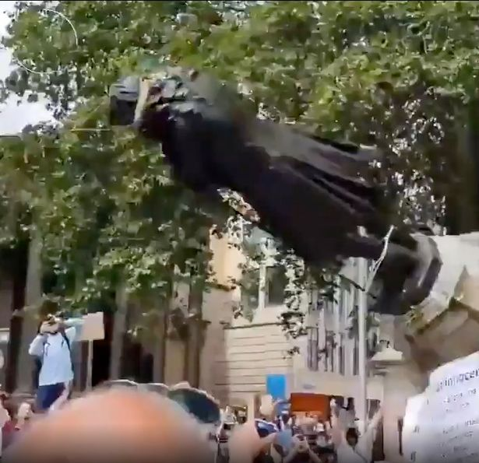
“The past is never dead. It's not even past.”
William Faulkner
Black Lives Matter protesters pull down statue of slave trader and roll it into river
[…] Black Lives Matter protesters have pulled down a statue of a 17th century slave trader and thrown it in the water in Bristol.
The bronze memorial of Edward Colston, which has been situated in Bristol city centre since 1895, was torn down after crowds left College Green.
It has been the subject of an 11,000-strong petition to have it removed.
After it was toppled, protesters rolled it towards the harbour and threw it into the water.
[…] Protesters used rope to pull the 17th century slave trader's memorial down "The man was a slave trader. He was generous to Bristol but it was off the back of slavery and it's absolutely despicable. It's an insult to the people of Bristol.“
Black Lives Matter protesters pull down statue of slave trader and roll it into river - Mirror Online

Slide 3

Video
Connect the quote of Faulkner to the video
“The past is never dead. It's not even past.” William Faulkner
discussion
results:

Slide 4
goal of this lesson
Video of protesters 5‘
postcolonialism and art 40‘
presentation 15‘
postcolonialism 15‘
date

Slide 5

postcolonialism and art
Form groups (2-3 students)
Read the text about the artist.
Look at the artpiece and explain how the artist criticises (post) colonialism. Take notes on the worksheet.
Collect words that come to your mind in a word cloud.
(Free online word cloud generator and tag cloud creator - WordClouds.com) take a screenshot
Create a collage inspired by the artwork and your wordcloud. Mind the postcolonial perspective.
work in groups

Slide 6


Gallery Walk
presenters
Present your artist, the artwork and your collage to the other groups.
Explain what inspired you and reflect your result.
listeners
Discuss with the group that your listening to about the idea of their collage.
presentation

Slide 7
Post colonialism
“The past is never dead. It's not even past.”
William Faulkner
Relate the quote of Faulkner to the artworks and your collage.
discussion

Slide 8
Post colonialism
Relate the quote of Faulkner to the artworks and your collage.
discussion
Results:
“The past is never dead. It's not even past.”
William Faulkner

Slide 9
Results
Upload the screenshot of your wordcloud, a photo of your collage and your explanation to your collage.
teams

Slide 10
Quellen
Text:
Jamie Hawkings: Black Lives Matters protesters pull down statue of slave trader and roll it into the river, 07.06.2020
[https://www.mirror.co.uk/news/uk-news/breaking-black-lives-matter-protesters-22152503, Letzter Zugriff 03.05.2023]
Video:
Black Lives Matters protesters pull down statue of slave trader and roll it into the river, 07.06.2020
[https://www.mirror.co.uk/news/uk-news/breaking-black-lives-matter-protesters-22152503, Letzter Zugriff 03.05.2023]
Text und Video

