Slide 1
“Art lives in history and history lives in art.“¹
Colonialism and Arts – An interdisciplinary unit
Notes:
1: Quote by Nigerian author Chimamanda Ngozi Adichie from a keynote speech at the opening of Humboldt Forum in Berlin
Erklärung: Jede der ausgewiesenen „Lessons“ war während der Durchführung des Projektes für 75 Minuten geplant.

Slide 2
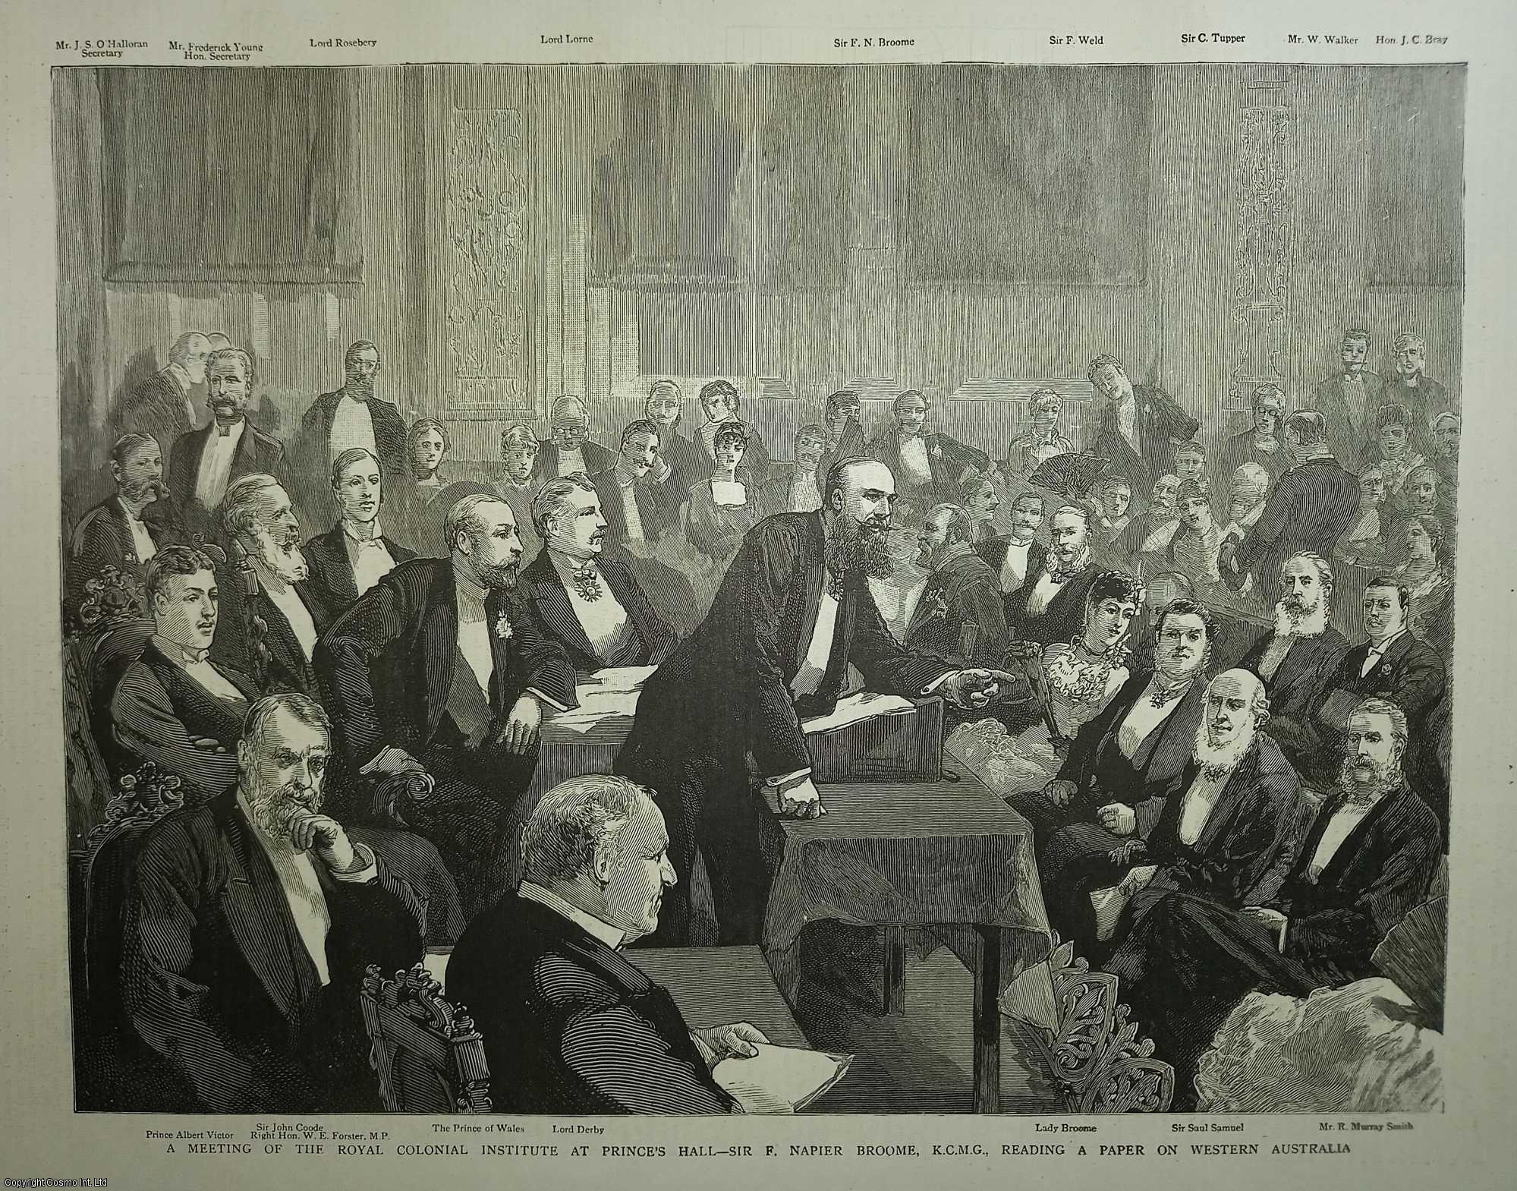
Lesson 3: Colonial Ideology
Read the background information at the top of the speech. Ask any questions that might arise due to the historically distant event or because of language.
What do you expect of the content of the speech?
A Meeting of the Royal Colonial Institute at Prince's Hall. Sir F. Napier Broome, K.C.M.G., Reading a Paper on Western Australia. An original print from the Graphic Illustrated Weekly Magazine, 1885. Royal Colonial Institute.
Notes:
Erklärung: Die Rede (siehe Anhang) wurde im Vergleich zu ihrem Original gekürzt, enthält jedoch alle relevanten Informationen, damit die Schüler*innen sich eine Bild von der Ideologie eines Verfechters der Kolonialisierung machen können. Es ist anzumerken, dass es zum Zeitpunkt der Rede bereits starke Stimmen gegen die Grausamkeiten des Kolonialismus gab. Dies ist auch als Hauptgrund anzusehen, weshalb sich Joseph Chamberlain in seiner Rede rechtfertig und versucht den Kolonialismus neu zu framen.

Slide 3
Lesson 3: Colonial Ideology
Read the speech and look up any words you do not understand with a (digital) dictionary.
Structure the speech into different parts and write a couple of notes in your own words for each of them.
Compare your notes with a partner. Check if you both chose the same information and if you understood the passages correctly. If the information differs a lot, discuss which result fits better.

Slide 4
Lesson 3: Colonial Ideology
Work out the theoretical basis on which Chamberlain argues, e.g. his line of argumentation. How does he justify the actions of the British Empire? Identify key phrases and sentences that you find particularly persuasive or problematic and give their lines as proof.
Tip: There are three main arguments in his speech.
Notes:
Erklärung: Dieser Teil der Verständnisaufgabe soll bereits die Analyse vorbereiten. Die Schüler*innen werden dafür sensibilisiert, dass die Stilmittel nicht einzeln in Reden vorkommen, sondern immer im Zusammenhang mit ihrer Intention zu untersuchen sind.
Es bietet sich an, die Argumentation anschließend zu diskutieren und die Schüler*innen mögliche Gegenpositionen formen zu lassen bzw. Chamberlains Argumentation zu kritisieren.

Slide 5
A possible solution to the line of argumentation
Argument 1: He argues that the conception of the British Empire has evolved over time, and that it has moved away from seeing the colonies as mere sources of profit for the mother country, to a more inclusive vision where colonies are considered part of the empire, united by ties of kinship, religion, history, and language and self-governing.
Argument 2: He presents imperialism as a civilizing mission, and argues that it brings benefits such as security, peace, and prosperity to the colonized countries. He frames this as a duty of the British Empire, and emphasizes the moral justification for the use of force, if necessary, to achieve this mission.
Argument 3: He highlights the importance of the colonies for the British Empire to stay strong in order to keep its position in the world. He presents colonialism as an opportunity for glory and honour and even a national mission that needs to be fulfilled.

Slide 6
Lesson 3: Colonial Ideology
We have already worked through the structure and the argumentation of the speech, the intention is also clear. The goal of our analysis is therefore to understand and explain, how Chamberlain tries to convince the audience other than on a logical level, e.g. filtering out his rhetorical strategies (as opposed to only the rhetorical devices).
Get together in groups of 2-3 students and look at the text snippets. Bring them in order to get the four strategies with their respective explanations and text examples.
Notes:
Erklärung: Die Gruppenarbeit soll auf eine schriftliche Analyse der Rede vorbereiten. Das Textpuzzle (siehe Anhang) sensibilisiert die Schüler*innen auf die Arbeitsweise einer Analyse vor.
Hausaufgabe: Use all the material and your results to write a complete analysis of Chamberlain‘s speech.

